Slide 1
Machine Learning Methods and Tools
Elena Zennaro, Wolfgang Ecker, Lorenzo Servadei

Slide 2
Training Neural Networks – Part II
Elena Zennaro, Wolfgang Ecker, Lorenzo Servadei

Slide 3
Agenda: Training Neural Networks – Part II
Optimization
Regularization
Transfer Learning
Embedded Systems
Fei-Fei Li & Justin Johnson & Serena Yeung Lecture 6 - April 20, 2017

Slide 4
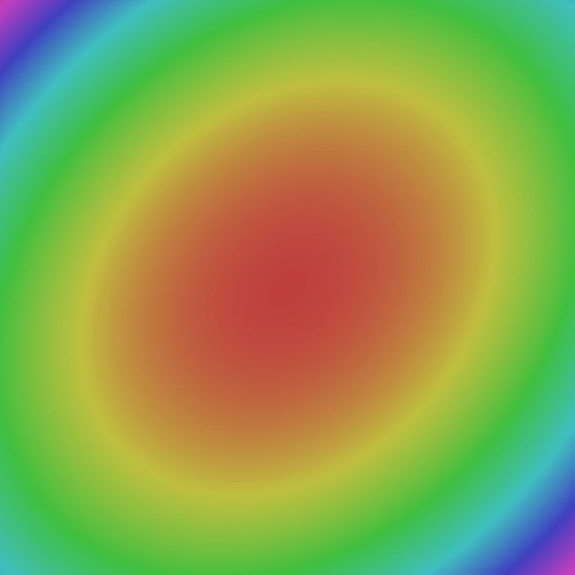
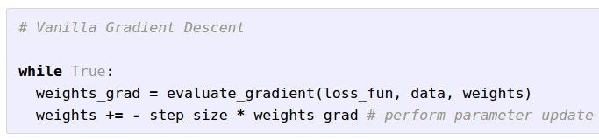

Optimization
W_2
W_1
Fei-Fei Li & Justin Johnson & Serena Yeung Lecture 7 - April 25, 2017

Slide 5
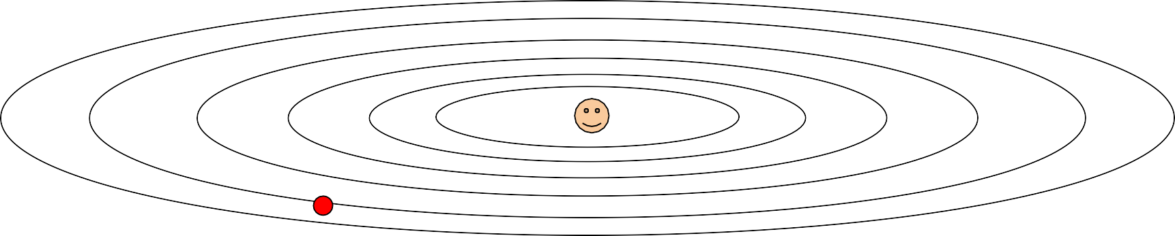
Optimization: Problems with SGD
What if loss changes quickly in one direction and slowly in another? What does gradient descent do?
Loss function has high condition number: ratio of largest to smallest
singular value of the Hessian matrix is large
Fei-Fei Li & Justin Johnson & Serena Yeung Lecture 7 - April 25, 2017

Slide 6
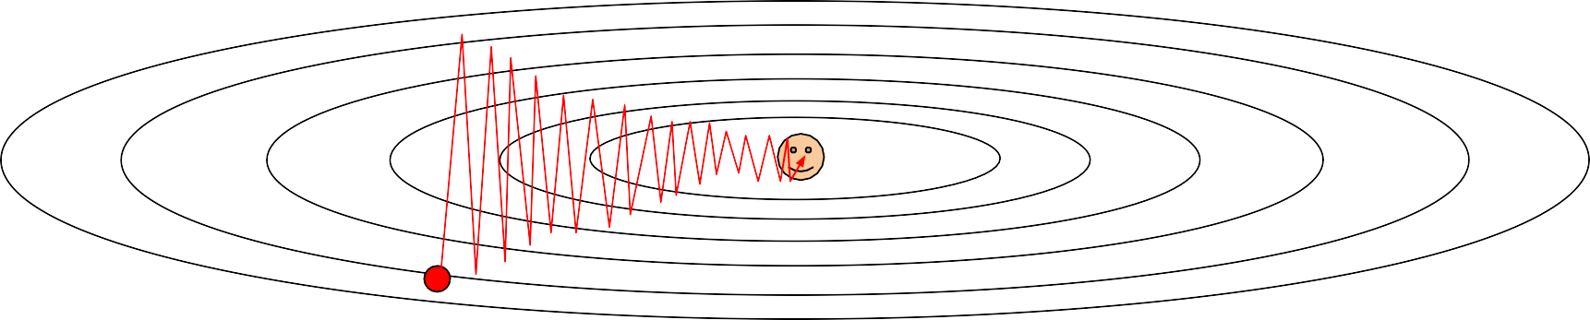
Optimization: Problems with SGD
What if loss changes quickly in one direction and slowly in another? What does gradient descent do?
Very slow progress along shallow dimension, jitter along steep direction
Loss function has high condition number: ratio of largest to smallest
singular value of the Hessian matrix is large
Fei-Fei Li & Justin Johnson & Serena Yeung Lecture 7 - April 25, 2017

Slide 7
Optimization: Problems with SGD
What if the loss function has a local minima or saddle point?
Fei-Fei Li & Justin Johnson & Serena Yeung Lecture 7 - April 25, 2017

Slide 8


Optimization: Problems with SGD
What if the loss function has a local minima or saddle point?
Zero gradient, gradient descent gets stuck
Fei-Fei Li & Justin Johnson & Serena Yeung Lecture 7 - April 25, 2017

Slide 9
Optimization: Problems with SGD
What if the loss function has a local minima or saddle point?
Saddle points much more common in high dimension
Dauphin et al, “Identifying and attacking the saddle point problem in high-dimensional non-convex optimization”, NIPS 2014
Fei-Fei Li & Justin Johnson & Serena Yeung Lecture 7 - April 25, 2017

Slide 10
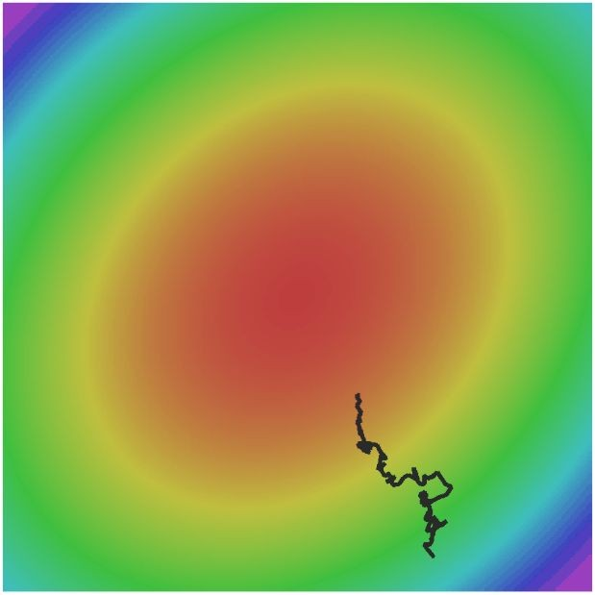
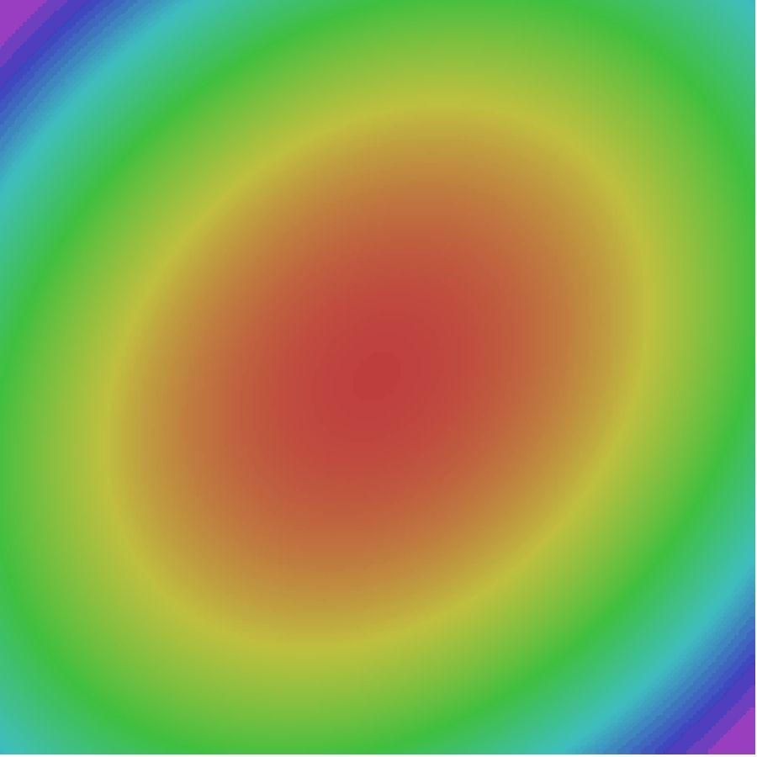
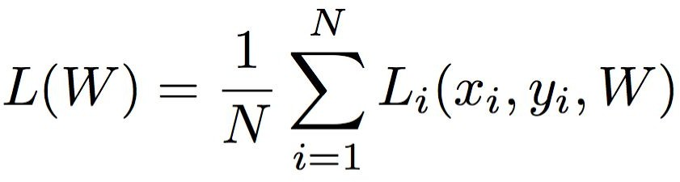
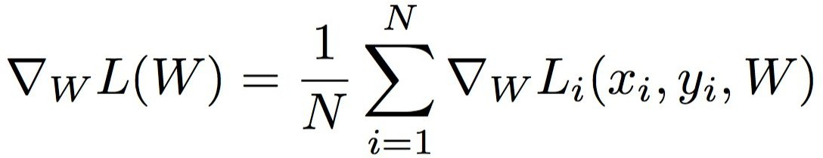
Optimization: Problems with SGD
Our gradients come from minibatches so they can be noisy!
Fei-Fei Li & Justin Johnson & Serena Yeung Lecture 7 - April 25, 2017

Slide 11
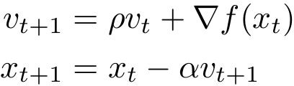
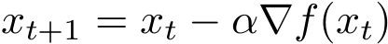
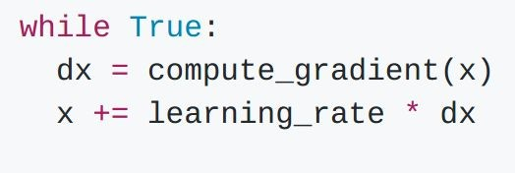
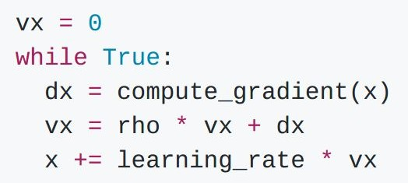
SGD + Momentum
SGD
SGD+Momentum
Build up “velocity” as a running mean of gradients
Rho gives “friction”; typically rho=0.9 or 0.99
Fei-Fei Li & Justin Johnson & Serena Yeung Lecture 7 - April 25, 2017

Slide 12
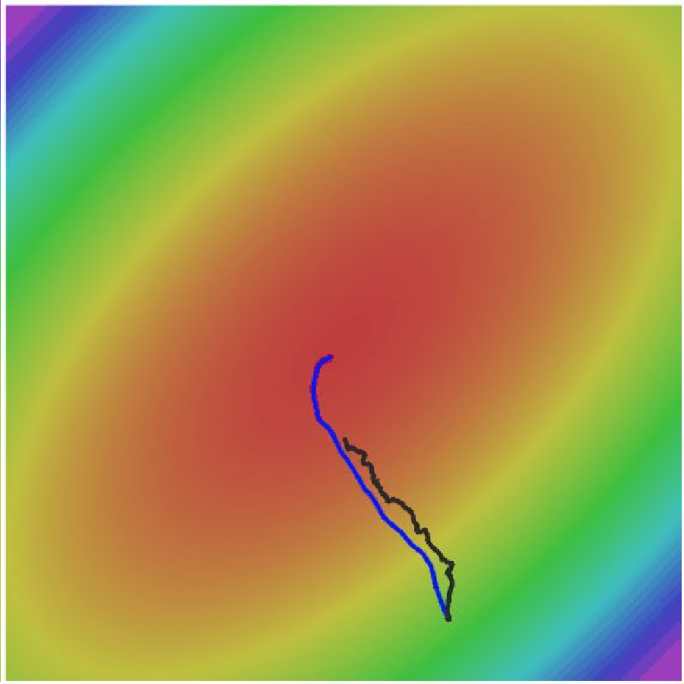
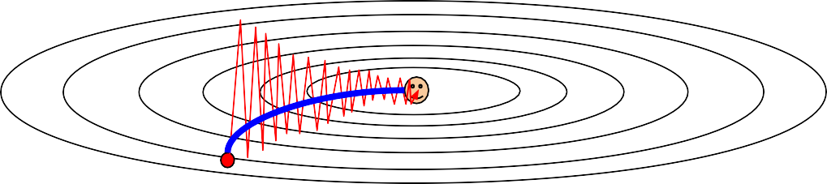
SGD + Momentum
Gradient Noise
Local Minima
Saddle points
Poor Conditioning
Fei-Fei Li & Justin Johnson & Serena Yeung Lecture 7 - April 25, 2017

Slide 13

SGD + Momentum
Momentum update:
Velocity
actual step
Gradient
Fei-Fei Li & Justin Johnson & Serena Yeung Lecture 7 - April 25, 2017

Slide 14

Nesterov Momentum
Momentum update:
Nesterov Momentum
Gradient
Velocity
Velocity
actual step
actual step
Gradient
Nesterov, “A method of solving a convex programming problem with convergence rate O(1/k^2)”, 1983 Nesterov, “Introductory lectures on convex optimization: a basic course”, 2004
Sutskever et al, “On the importance of initialization and momentum in deel learning”, ICML 2013
Fei-Fei Li & Justin Johnson & Serena Yeung Lecture 7 - April 25, 2017

Slide 15
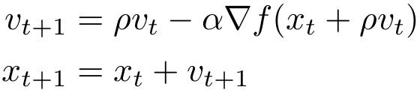
Nesterov Momentum
Fei-Fei Li & Justin Johnson & Serena Yeung Lecture 7 - April 25, 2017

Slide 16
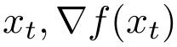
Nesterov Momentum
Annoying, usually we want update in terms of
Fei-Fei Li & Justin Johnson & Serena Yeung Lecture 7 - April 25, 2017

Slide 17
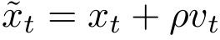
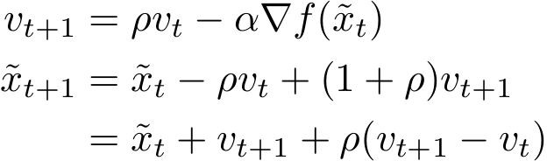
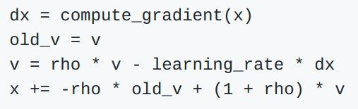
Nesterov Momentum
Annoying, usually we want update in terms of
Change of variables rearrange:
and
Fei-Fei Li & Justin Johnson & Serena Yeung Lecture 7 - April 25, 2017

Slide 18
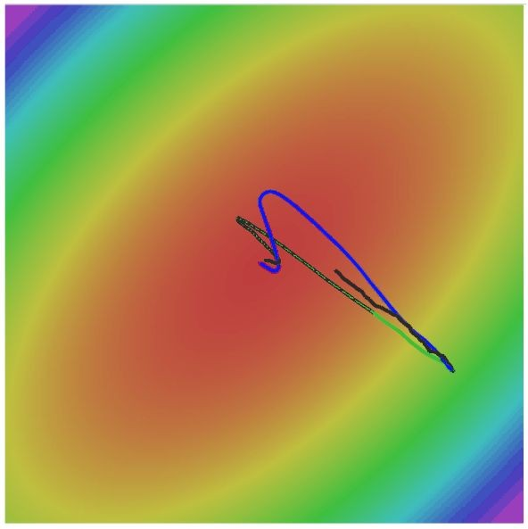
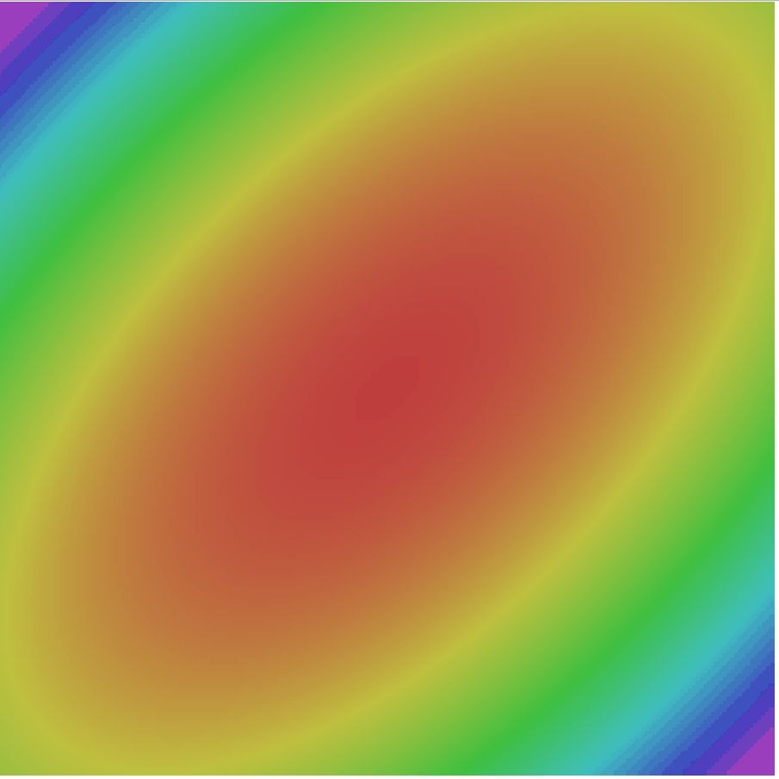
Nesterov Momentum
SGD
SGD+Momentum Nesterov
Fei-Fei Li & Justin Johnson & Serena Yeung Lecture 7 - April 25, 2017

Slide 19
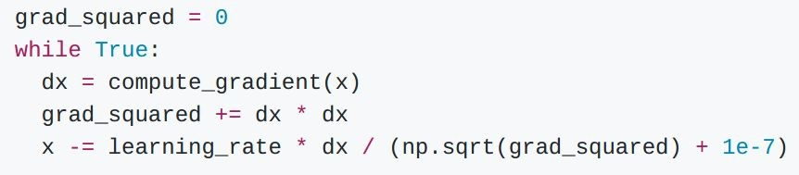
AdaGrad
Added element-wise scaling of the gradient based on the historical sum of squares in each dimension
Duchi et al, “Adaptive subgradient methods for online learning and stochastic optimization”, JMLR 2011
Fei-Fei Li & Justin Johnson & Serena Yeung Lecture 7 - April 25, 2017

Slide 20

AdaGrad
Q: What happens with AdaGrad?
Fei-Fei Li & Justin Johnson & Serena Yeung Lecture 7 - April 25, 2017

Slide 21
AdaGrad
Q2: What happens to the step size over long time?
Fei-Fei Li & Justin Johnson & Serena Yeung Lecture 7 - April 25, 2017

Slide 22

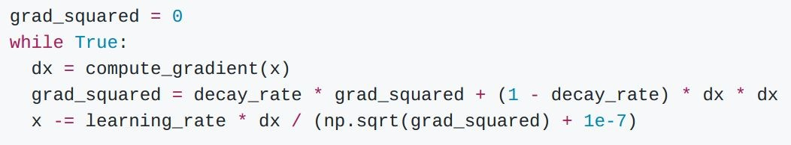
RMSProp
AdaGrad
RMSProp
Tieleman and Hinton, 2012
Fei-Fei Li & Justin Johnson & Serena Yeung Lecture 7 - April 25, 2017

Slide 23
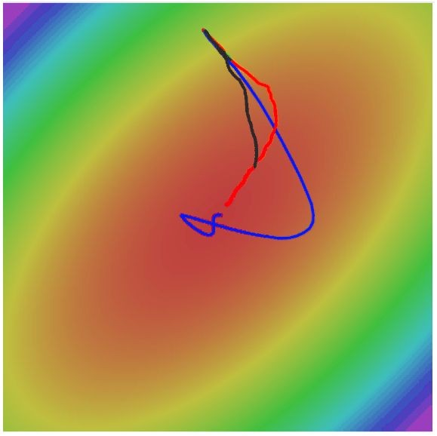
RMSProp
SGD
SGD+Momentum RMSProp
Fei-Fei Li & Justin Johnson & Serena Yeung Lecture 7 - April 25, 2017

Slide 24
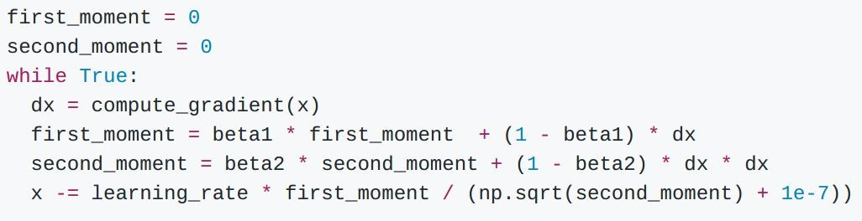
Adam (almost)
Kingma and Ba, “Adam: A method for stochastic optimization”, ICLR 2015
Fei-Fei Li & Justin Johnson & Serena Yeung Lecture 7 - April 25, 2017

Slide 25
Adam (almost)
Momentum
AdaGrad / RMSProp
Sort of like RMSProp with momentum
Q: What happens at first timestep?
Kingma and Ba, “Adam: A method for stochastic optimization”, ICLR 2015
Fei-Fei Li & Justin Johnson & Serena Yeung Lecture 7 - April 25, 2017

Slide 26
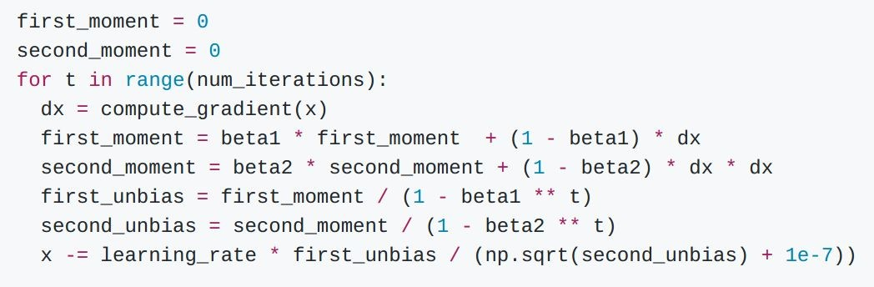
Adam (full form)
Momentum
Bias correction
AdaGrad / RMSProp
Bias correction for the fact that first and second moment estimates start at zero
Kingma and Ba, “Adam: A method for stochastic optimization”, ICLR 2015
Fei-Fei Li & Justin Johnson & Serena Yeung Lecture 7 - April 25, 2017

Slide 27
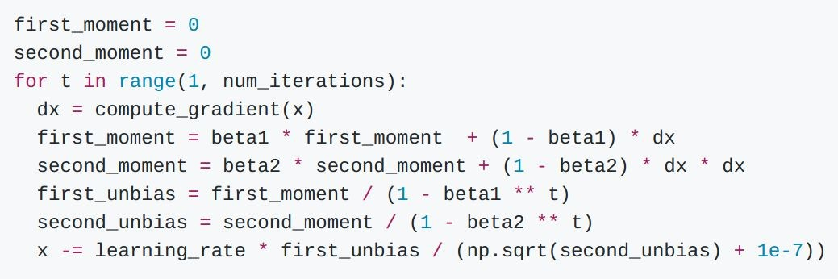
Adam (full form)
Momentum
Bias correction
AdaGrad / RMSProp
Bias correction for the fact that first and second moment estimates start at zero
Adam with beta1 = 0.9,
beta2 = 0.999, and learning_rate = 1e-3 or 5e-4 is a great starting point for many models!
Kingma and Ba, “Adam: A method for stochastic optimization”, ICLR 2015
Fei-Fei Li & Justin Johnson & Serena Yeung Lecture 7 - April 25, 2017

Slide 28
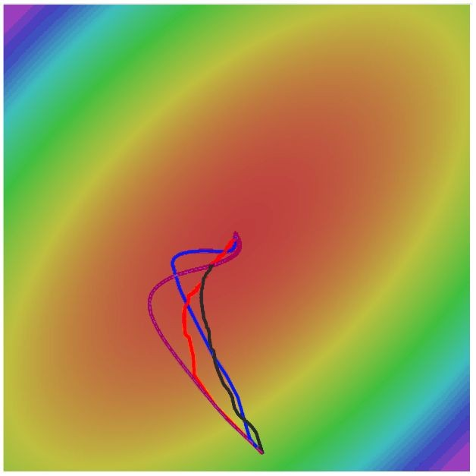
Adam
SGD
SGD+Momentum RMSProp
Adam
Fei-Fei Li & Justin Johnson & Serena Yeung Lecture 7 - April 25, 2017

Slide 29
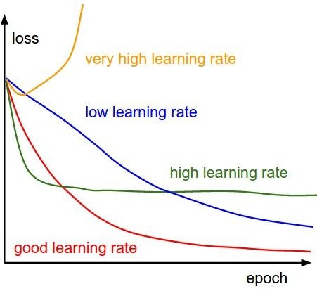
SGD, SGD+Momentum, Adagrad, RMSProp, Adam all have
learning rate as a hyperparameter.
Q: Which one of these learning rates is best to use?
Fei-Fei Li & Justin Johnson & Serena Yeung Lecture 7 - April 25, 2017

Slide 30
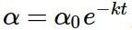
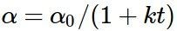
SGD, SGD+Momentum, Adagrad, RMSProp, Adam all have
learning rate as a hyperparameter.
=> Learning rate decay over time!
step decay:
e.g. decay learning rate by half every few epochs.
exponential decay:
1/t decay:
Fei-Fei Li & Justin Johnson & Serena Yeung Lecture 7 - April 25, 2017

Slide 31
SGD, SGD+Momentum, Adagrad, RMSProp, Adam all have
learning rate as a hyperparameter.
Loss
Learning rate decay!
Epoch
Fei-Fei Li & Justin Johnson & Serena Yeung Lecture 7 - April 25, 2017

Slide 32
SGD, SGD+Momentum, Adagrad, RMSProp, Adam all have
learning rate as a hyperparameter.
Loss
Learning rate decay!
More critical with SGD+Momentum, less common with Adam
Epoch
Fei-Fei Li & Justin Johnson & Serena Yeung Lecture 7 - April 25, 2017

Slide 33
First-Order Optimization
Loss
w1
Fei-Fei Li & Justin Johnson & Serena Yeung Lecture 7 - April 25, 2017

Slide 34

First-Order Optimization
Use gradient form linear approximation
Step to minimize the approximation
Loss
w1
Fei-Fei Li & Justin Johnson & Serena Yeung Lecture 7 - April 25, 2017

Slide 35

Second-Order Optimization
Use gradient and Hessian to form quadratic approximation
Step to the minima of the approximation
Loss
w1
Fei-Fei Li & Justin Johnson & Serena Yeung Lecture 7 - April 25, 2017

Slide 36
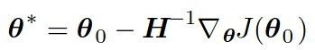
Second-Order Optimization
second-order Taylor expansion:
Solving for the critical point we obtain the Newton parameter update:
Q: What is nice about this update?
Fei-Fei Li & Justin Johnson & Serena Yeung Lecture 7 - April 25, 2017

Slide 37
Second-Order Optimization
second-order Taylor expansion:
Solving for the critical point we obtain the Newton parameter update:
No hyperparameters! No learning rate!
Q: What is nice about this update?
Fei-Fei Li & Justin Johnson & Serena Yeung Lecture 7 - April 25, 2017

Slide 38
Second-Order Optimization
second-order Taylor expansion:
Solving for the critical point we obtain the Newton parameter update:
Hessian has O(N^2) elements Inverting takes O(N^3)
N = (Tens or Hundreds of) Millions
Q2: Why is this bad for deep learning?
Fei-Fei Li & Justin Johnson & Serena Yeung Lecture 7 - April 25, 2017

Slide 39
Second-Order Optimization
Quasi-Newton methods (BGFS most popular):
instead of inverting the Hessian (O(n^3)), approximate inverse Hessian with rank 1 updates over time (O(n^2) each).
L-BFGS (Limited memory BFGS):
Does not form/store the full inverse Hessian.
Fei-Fei Li & Justin Johnson & Serena Yeung Lecture 7 - April 25, 2017

Slide 40
L-BFGS
- Usually works very well in full batch, deterministic mode
i.e. if you have a single, deterministic f(x) then L-BFGS will probably work very nicely
- Does not transfer very well to mini-batch setting. Gives bad results. Adapting L-BFGS to large-scale, stochastic setting is an active area of research.
Le et al, “On optimization methods for deep learning, ICML 2011”
Fei-Fei Li & Justin Johnson & Serena Yeung Lecture 7 - April 25, 2017

Slide 41
In practice:
Adam is a good default choice in most cases
If you can afford to do full batch updates then try out
L-BFGS (and don’t forget to disable all sources of noise)
Fei-Fei Li & Justin Johnson & Serena Yeung Lecture 7 - April 25, 2017

Slide 42
Agenda: Training Neural Networks – Part II
Optimization
Regularization
Transfer Learning
Embedded Systems
Fei-Fei Li & Justin Johnson & Serena Yeung Lecture 6 - April 20, 2017

Slide 43
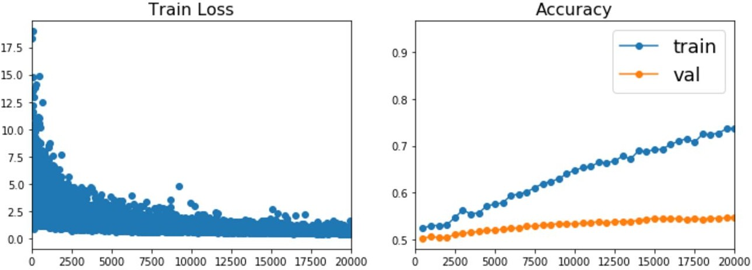
Beyond Training Error
Better optimization algorithms help reduce training loss
But we really care about error on new data - how to reduce the gap?
Fei-Fei Li & Justin Johnson & Serena Yeung Lecture 7 - April 25, 2017

Slide 44
Model Ensembles
Train multiple independent models
At test time average their results
Enjoy 2% extra performance
Fei-Fei Li & Justin Johnson & Serena Yeung Lecture 7 - April 25, 2017

Slide 45
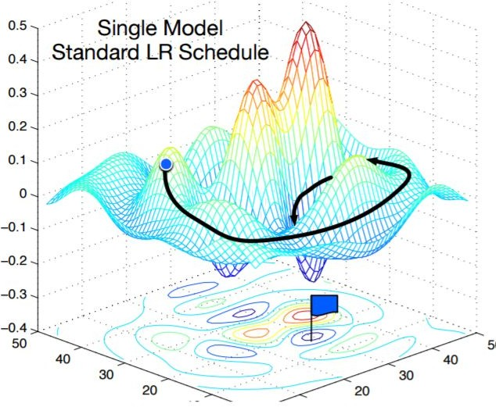
Model Ensembles: Tips and Tricks
Instead of training independent models, use multiple snapshots of a single model during training!
Loshchilov and Hutter, “SGDR: Stochastic gradient descent with restarts”, arXiv 2016 Huang et al, “Snapshot ensembles: train 1, get M for free”, ICLR 2017
Figures copyright Yixuan Li and Geoff Pleiss, 2017. Reproduced with permission.
Fei-Fei Li & Justin Johnson & Serena Yeung Lecture 7 - April 25, 2017

Slide 46
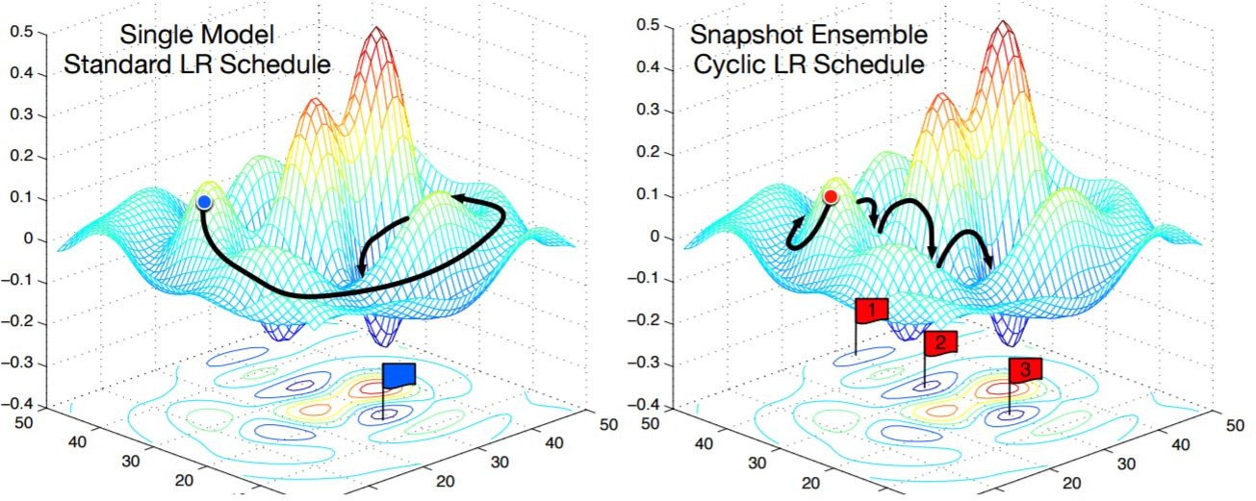
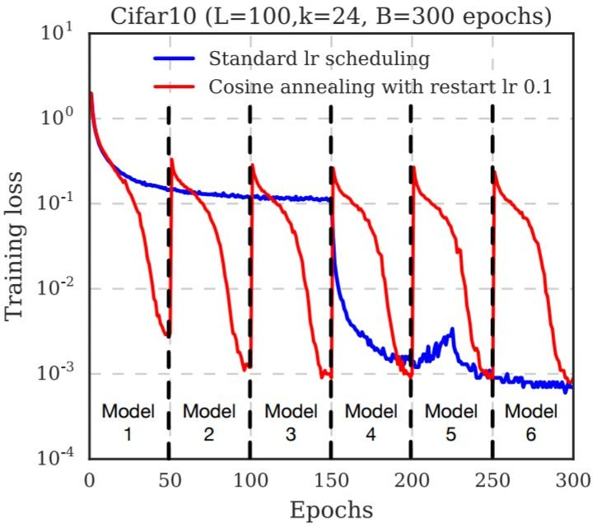
Model Ensembles: Tips and Tricks
Instead of training independent models, use multiple snapshots of a single model during training!
Loshchilov and Hutter, “SGDR: Stochastic gradient descent with restarts”, arXiv 2016 Huang et al, “Snapshot ensembles: train 1, get M for free”, ICLR 2017
Figures copyright Yixuan Li and Geoff Pleiss, 2017. Reproduced with permission.
Cyclic learning rate schedules can make this work even better!
Lecture 7 - 56
Fei-Fei Li & Justin Johnson & Serena Yeung Lecture 7 - April 25, 2017

Slide 47
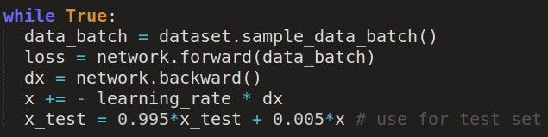
Model Ensembles: Tips and Tricks
Instead of using actual parameter vector, keep a moving average of the parameter vector and use that at test time (Polyak averaging)
Polyak and Juditsky, “Acceleration of stochastic approximation by averaging”, SIAM Journal on Control and Optimization, 1992.
Fei-Fei Li & Justin Johnson & Serena Yeung Lecture 7 - April 25, 2017

Slide 48
How to improve single-model performance?
Regularization
Fei-Fei Li & Justin Johnson & Serena Yeung Lecture 7 - April 25, 2017

Slide 49
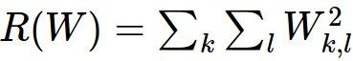
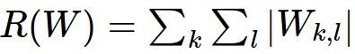
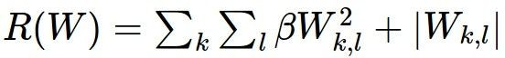
Regularization: Add term to loss
In common use: L2 regularization L1 regularization
Elastic net (L1 + L2)
(Weight decay)
Fei-ei Li & Justin Johnson & Serena Yeung Lecture 7 - April 25, 2017

Slide 50



Regularization: Dropout
In each forward pass, randomly set some neurons to zero Probability of dropping is a hyperparameter; 0.5 is common
Srivastava et al, “Dropout: A simple way to prevent neural networks from overfitting”, JMLR 2014
Fei-Fei Li & Justin Johnson & Serena Yeung Lecture 7 - April 25, 2017

Slide 51
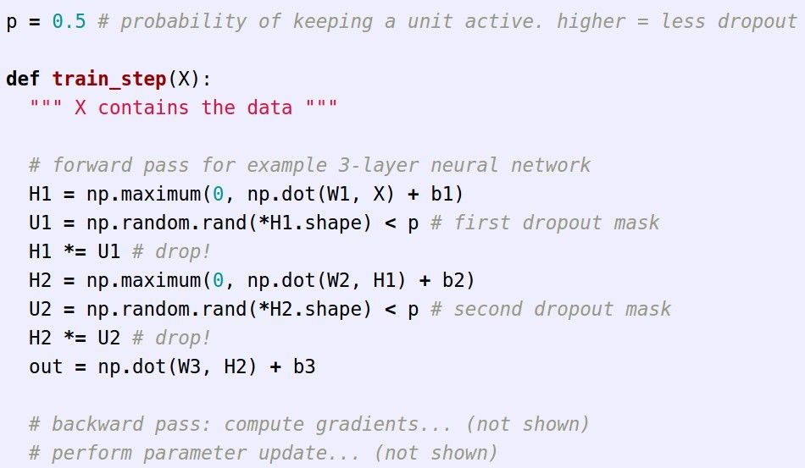



Regularization: Dropout
Example forward pass with a
3-layer network using dropout
Fei-Fei Li & Justin Johnson & Serena Yeung Lecture 7 - April 25, 2017

Slide 52



Regularization: Dropout
How can this possibly be a good idea?
Forces the network to have a redundant representation; Prevents co-adaptation of features
has an ear
has a tail is furry has claws
mischievous X
look
X
X
cat score
Fei-Fei Li & Justin Johnson & Serena Yeung Lecture 7 - April 25, 2017

Slide 53
Regularization: Dropout
How can this possibly be a good idea?
Another interpretation:
Dropout is training a large ensemble of models (that share parameters).
Each binary mask is one model
An FC layer with 4096 units has 2⁴⁰⁹⁶ ~ 10¹²³³ possible masks!
Only ~ 10⁸² atoms in the universe...
Fei-Fei Li & Justin Johnson & Serena Yeung Lecture 7 - April 25, 2017

Slide 54
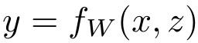
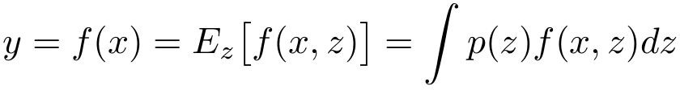
Dropout: Test time
Output (label)
Input (image)
Dropout makes our output random!
Random mask
Want to “average out” the randomness at test-time
But this integral seems hard …
Fei-Fei Li & Justin Johnson & Serena Yeung Lecture 7 - April 25, 2017

Slide 55


Dropout: Test time
Want to approximate the integral
Consider a single neuron.
a
w₁
w₂
x
y
Fei-Fei Li & Justin Johnson & Serena Yeung Lecture 7 - April 25, 2017

Slide 56
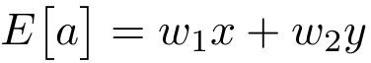
Dropout: Test time
Want to approximate the integral
Consider a single neuron.
a
At test time we have:
w₁
w₂
x
y
Fei-Fei Li & Justin Johnson & Serena Yeung Lecture 7 - April 25, 2017

Slide 57
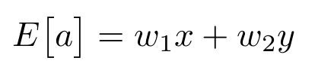
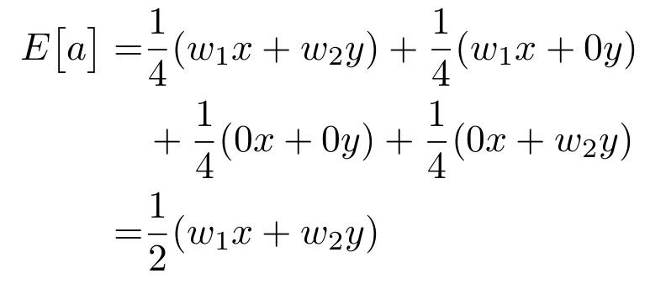
Dropout: Test time
Want to approximate the integral
Consider a single neuron.
a
At test time we have: During training we have:
w₁
w₂
x
y
Fei-Fei Li & Justin Johnson & Serena Yeung Lecture 7 - April 25, 2017

Slide 58
Dropout: Test time
Want to approximate the integral
Consider a single neuron.
a
At test time we have: During training we have:
w₁
w₂
x
y
At test time, multiply
by dropout probability
Fei-Fei Li & Justin Johnson & Serena Yeung Lecture 7 - April 25, 2017

Slide 59
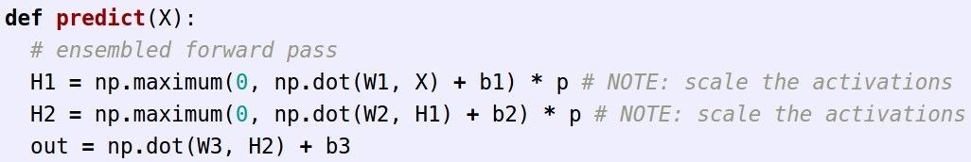
Dropout: Test time
At test time all neurons are active always
=> We must scale the activations so that for each neuron: output at test time = expected output at training time
Fei-Fei Li & Justin Johnson & Serena Yeung Lecture 7 - April 25, 2017

Slide 60
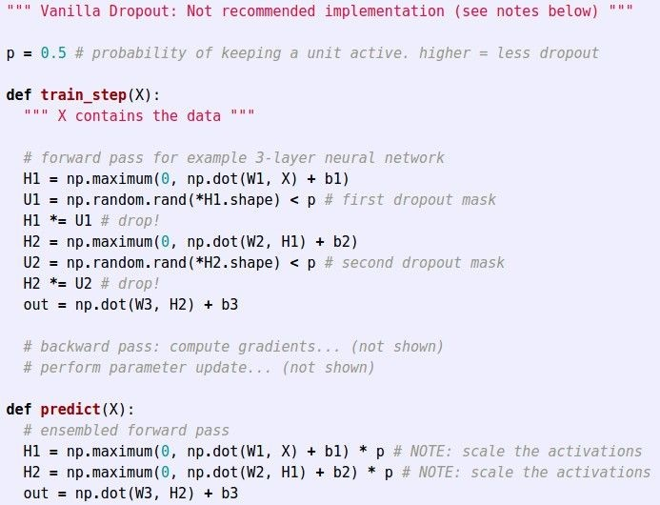
Dropout Summary
drop in forward pass
scale at test time
Fei-Fei Li & Justin Johnson & Serena Yeung Lecture 7 - April 25, 2017

Slide 61
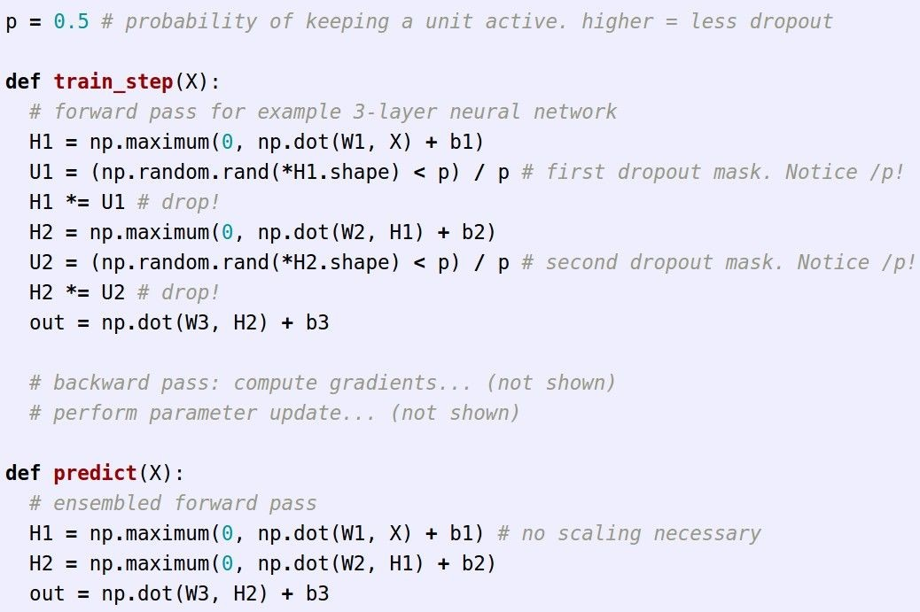
More common: “Inverted dropout”
test time is unchanged!
Fei-Fei Li & Justin Johnson & Serena Yeung Lecture 7 - April 25, 2017

Slide 62
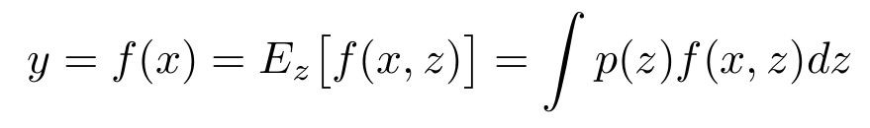
Regularization: A common pattern
Training: Add some kind of randomness
Testing: Average out randomness (sometimes approximate)
Fei-Fei Li & Justin Johnson & Serena Yeung Lecture 7 - April 25, 2017

Slide 63
Regularization: A common pattern
Training: Add some kind of randomness
Example: Batch Normalization
Training: Normalize using stats from random minibatches
Testing: Use fixed stats to normalize
Testing: Average out randomness (sometimes approximate)
Fei-Fei Li & Justin Johnson & Serena Yeung Lecture 7 - April 25, 2017

Slide 64

Regularization: Data Augmentation
“cat”
Load image and label
Compute loss
CNN
This image by Nikita is licensed under CC-BY 2.0
Fei-Fei Li & Justin Johnson & Serena Yeung Lecture 7 - April 25, 2017

Slide 65

Regularization: Data Augmentation
“cat”
Load image and label
Compute loss
CNN
Transform image
Fei-Fei Li & Justin Johnson & Serena Yeung Lecture 7 - April 25, 2017

Slide 66

Data Augmentation
Horizontal Flips
Fei-Fei Li & Justin Johnson & Serena Yeung Lecture 7 - April 25, 2017

Slide 67
Data Augmentation
Random crops and scales
Training: sample random crops / scales
ResNet:
Pick random L in range [256, 480]
Resize training image, short side = L
Sample random 224 x 224 patch
Fei-Fei Li & Justin Johnson & Serena Yeung Lecture 7 - April 25, 2017

Slide 68
Data Augmentation
Random crops and scales
Training: sample random crops / scales
ResNet:
Pick random L in range [256, 480]
Resize training image, short side = L
Sample random 224 x 224 patch
Testing: average a fixed set of crops
ResNet:
1. Resize image at 5 scales: {224, 256, 384, 480, 640}
2. For each size, use 10 224 x 224 crops: 4 corners + center, + flips
Fei-Fei Li & Justin Johnson & Serena Yeung Lecture 7 - April 25, 2017

Slide 69

Data Augmentation
Color Jitter
Simple: Randomize contrast and brightness
Fei-Fei Li & Justin Johnson & Serena Yeung Lecture 7 - April 25, 2017

Slide 70
Data Augmentation
Color Jitter
Simple: Randomize contrast and brightness
More Complex:
Apply PCA to all [R, G, B] pixels in training set
Sample a “color offset” along principal component directions
Add offset to all pixels of a training image
Fei-Fei Li & Justin Johnson & Serena Yeung Lecture 7 - April 25, 2017
(As seen in [Krizhevsky et al. 2012], ResNet, etc)

Slide 71
Data Augmentation
Get creative for your problem!
Random mix/combinations of :
translation
rotation
stretching
shearing,
lens distortions, … (go crazy)
Fei-Fei Li & Justin Johnson & Serena Yeung Lecture 7 - April 25, 2017

Slide 72
Regularization: A common pattern
Training: Add random noise
Testing: Marginalize over the noise
Examples: Dropout
Batch Normalization Data Augmentation
Fei-Fei Li & Justin Johnson & Serena Yeung Lecture 7 - April 25, 2017

Slide 73
Regularization: A common pattern
Training: Add random noise
Testing: Marginalize over the noise
Examples: Dropout
Batch Normalization Data Augmentation DropConnect
Wan et al, “Regularization of Neural Networks using DropConnect”, ICML 2013
Fei-Fei Li & Justin Johnson & Serena Yeung Lecture 7 - April 25, 2017

Slide 74

Regularization: A common pattern
Training: Add random noise
Testing: Marginalize over the noise
Examples: Dropout
Batch Normalization Data Augmentation DropConnect Fractional Max Pooling
Graham, “Fractional Max Pooling”, arXiv 2014
Lecture 7 - 84
Fei-Fei Li & Justin Johnson & Serena Yeung Lecture 7 - April 25, 2017

Slide 75
Regularization: A common pattern
Training: Add random noise
Testing: Marginalize over the noise
Examples: Dropout
Batch Normalization Data Augmentation DropConnect Fractional Max Pooling Stochastic Depth
Huang et al, “Deep Networks with Stochastic Depth”, ECCV 2016
Fei-Fei Li & Justin Johnson & Serena Yeung Lecture 7 - April 25, 2017

Slide 76

Regularization: A common pattern
Training: Add random noise
Testing: Marginalize over the noise
Examples: Dropout
Batch Normalization Data Augmentation DropConnect Fractional Max Pooling Stochastic Depth
Huang et al, “Deep Networks with Stochastic Depth”, ECCV 2016
Fei-Fei Li & Justin Johnson & Serena Yeung Lecture 7 - April 25, 2017

Slide 77
Agenda: Training Neural Networks – Part II
Optimization
Regularization
Transfer Learning
Embedded Systems
Fei-Fei Li & Justin Johnson & Serena Yeung Lecture 6 - April 20, 2017

Slide 78
Transfer Learning
“You need a lot of a data if you want to train/use Deep Neural Networks”
Fei-Fei Li & Justin Johnson & Serena Yeung Lecture 7 - April 25, 2017

Slide 79
Transfer Learning
“You need a lot of a data if you want to train/use Deep Neural Networks”
BUSTED
Fei-Fei Li & Justin Johnson & Serena Yeung Lecture 7 - April 25, 2017

Slide 80
Transfer Learning with CNNs
Donahue et al, “DeCAF: A Deep Convolutional Activation Feature for Generic Visual Recognition”, ICML 2014 Razavian et al, “CNN Features Off-the-Shelf: An Astounding Baseline for Recognition”, CVPR Workshops 2014
1. Train on Imagenet
FC-1000
FC-4096
FC-4096
MaxPool
Conv-512
Conv-512
MaxPool
Conv-512
Conv-512
MaxPool
Conv-256
Conv-256
MaxPool
Conv-128
Conv-128
MaxPool
Conv-64
Conv-64
Image
Fei-Fei Li & Justin Johnson & Serena Yeung Lecture 7 - April 25, 2017

Slide 81

Transfer Learning with CNNs
Donahue et al, “DeCAF: A Deep Convolutional Activation Feature for Generic Visual Recognition”, ICML 2014 Razavian et al, “CNN Features Off-the-Shelf: An Astounding Baseline for Recognition”, CVPR Workshops 2014
1. Train on Imagenet
2. Small Dataset (C classes)
FC-1000
FC-4096
FC-4096
 | FC-C
 | FC-4096
 | FC-4096
Reinitialize this and train
MaxPool
Conv-512
Conv-512
MaxPool
Conv-512
Conv-512
MaxPool
Conv-512
Conv-512
MaxPool
Conv-512
Conv-512
MaxPool
Conv-256
Conv-256
MaxPool
Conv-256
Conv-256
Freeze these
MaxPool
Conv-128
Conv-128
MaxPool
Conv-128
Conv-128
MaxPool
Conv-64
Conv-64
MaxPool
Conv-64
Conv-64
Image
Image
Lecture 7 - 89
Fei-Fei Li & Justin Johnson & Serena Yeung Lecture 7 - April 25, 2017

Slide 82
Transfer Learning with CNNs
Donahue et al, “DeCAF: A Deep Convolutional Activation Feature for Generic Visual Recognition”, ICML 2014 Razavian et al, “CNN Features Off-the-Shelf: An Astounding Baseline for Recognition”, CVPR Workshops 2014
3. Bigger dataset
1. Train on Imagenet
2. Small Dataset (C classes)
FC-1000
FC-4096
FC-4096
 | FC-C
 | FC-4096
 | FC-4096
FC-C
FC-4096
FC-4096
Reinitialize this and train
Train these
MaxPool
Conv-512
Conv-512
MaxPool
Conv-512
Conv-512
MaxPool
Conv-512
With bigger dataset, train more layers
Conv-512
MaxPool
Conv-512
Conv-512
MaxPool
Conv-512
Conv-512
MaxPool
Conv-512
Conv-512
MaxPool
Conv-256
Conv-256
MaxPool
Conv-256
Conv-256
Freeze these
MaxPool
Conv-256
Conv-256
Freeze these
Lower learning rate when finetuning; 1/10 of original LR is good starting point
MaxPool
Conv-128
Conv-128
MaxPool
Conv-128
Conv-128
MaxPool
Conv-128
Conv-128
MaxPool
Conv-64
Conv-64
MaxPool
Conv-64
Conv-64
MaxPool
Conv-64
Conv-64
Image
Image
Image
Fei-Fei Li & Justin Johnson & Serena Yeung Lecture 7 - April 25, 2017

Slide 83
FC-1000
FC-4096
FC-4096
 | very similar dataset | very different dataset
very little data | ? | ?
quite a lot of data | ? | ?
MaxPool
Conv-512
Conv-512
MaxPool
Conv-512
Conv-512
More specific
More generic
MaxPool
Conv-256
Conv-256
MaxPool
Conv-128
Conv-128
MaxPool
Conv-64
Conv-64
Image
Fei-Fei Li & Justin Johnson & Serena Yeung Lecture 7 - April 25, 2017

Slide 84
FC-1000
FC-4096
FC-4096
 | very similar dataset | very different dataset
very little data | Use Linear Classifier on top layer | ?
quite a lot of data | Finetune a few layers | ?
MaxPool
Conv-512
Conv-512
MaxPool
Conv-512
Conv-512
More specific
More generic
MaxPool
Conv-256
Conv-256
MaxPool
Conv-128
Conv-128
MaxPool
Conv-64
Conv-64
Image
Fei-Fei Li & Justin Johnson & Serena Yeung Lecture 7 - April 25, 2017

Slide 85
FC-1000
FC-4096
FC-4096
 | very similar dataset | very different dataset
very little data | Use Linear Classifier on top layer | You’re in trouble… Try linear classifier from different stages
quite a lot of data | Finetune a few layers | Finetune a larger number of layers
MaxPool
Conv-512
Conv-512
MaxPool
Conv-512
Conv-512
More specific
More generic
MaxPool
Conv-256
Conv-256
MaxPool
Conv-128
Conv-128
MaxPool
Conv-64
Conv-64
Image
Fei-Fei Li & Justin Johnson & Serena Yeung Lecture 7 - April 25, 2017

Slide 86


Transfer learning with CNNs is pervasive…
(it’s the norm, not an exception)
Object Detection
(Fast R-CNN)
Image Captioning: CNN + RNN
Girshick, “Fast R-CNN”, ICCV 2015
Figure copyright Ross Girshick, 2015. Reproduced with permission.
Karpathy and Fei-Fei, “Deep Visual-Semantic Alignments for Generating Image Descriptions”, CVPR 2015
Figure copyright IEEE, 2015. Reproduced for educational purposes.
Fei-Fei Li & Justin Johnson & Serena Yeung Lecture 7 - April 25, 2017

Slide 87
Transfer learning with CNNs is pervasive…
(it’s the norm, not an exception)
Object Detection
CNN pretrained on ImageNet
(Fast R-CNN)
Image Captioning: CNN + RNN
Girshick, “Fast R-CNN”, ICCV 2015
Figure copyright Ross Girshick, 2015. Reproduced with permission.
Karpathy and Fei-Fei, “Deep Visual-Semantic Alignments for Generating Image Descriptions”, CVPR 2015
Figure copyright IEEE, 2015. Reproduced for educational purposes.
Fei-Fei Li & Justin Johnson & Serena Yeung Lecture 7 - April 25, 2017

Slide 88
Transfer learning with CNNs is pervasive…
(it’s the norm, not an exception)
Object Detection
CNN pretrained on ImageNet
(Fast R-CNN)
Image Captioning: CNN + RNN
Word vectors pretrained
with word2vec
Girshick, “Fast R-CNN”, ICCV 2015
Figure copyright Ross Girshick, 2015. Reproduced with permission.
Karpathy and Fei-Fei, “Deep Visual-Semantic Alignments for Generating Image Descriptions”, CVPR 2015
Figure copyright IEEE, 2015. Reproduced for educational purposes.
Fei-Fei Li & Justin Johnson & Serena Yeung Lecture 7 - April 25, 2017

Slide 89
Takeaway for your projects and beyond:
Have some dataset of interest but it has < ~1M images?
Find a very large dataset that has similar data, train a big Network there
Transfer learn to your dataset
Deep learning frameworks provide a “Model Zoo” of pretrained models so you don’t need to train your own
Caffe: https://github.com/BVLC/caffe/wiki/Model-Zoo TensorFlow: https://github.com/tensorflow/models PyTorch: https://github.com/pytorch/vision
Fei-Fei Li & Justin Johnson & Serena Yeung Lecture 7 - April 25, 2017

Slide 90
Optimization
Regularization
Transfer Learning
Embedded Systems

Slide 91


Models are Getting Larger
IMAGE RECOGNITION
SPEECH RECOGNITION
16X
Model
10X
Training Ops
152 layers
22.6 GFLOP
~3.5% error
465 GFLOP
12,000 hrs of Data
~5% Error
8 layers
1.4 GFLOP
~16% Error
80 GFLOP
7,000 hrs of Data
~8% Error
2012
AlexNet
2015
ResNet
2014
Deep Speech 1
2015
Deep Speech 2
Microsoft Baidu
Dally, NIPS’2016 workshop on Efficient Methods for Deep Neural Networks

Slide 92









The first Challenge: Model Size
Hard to distribute large models through over-the-air update
App icon is in the public domain Phone image is licensed under CC-BY 2.0
This image is licensed under CC-BY 2.0

Slide 93
The Second Challenge: Speed
Error rate
Training time
ResNet18: | 10.76% | 2.5 days
ResNet50: | 7.02% | 5 days
ResNet101: | 6.21% | 1 week
ResNet152: | 6.16% | 1.5weeks
Such long training time limits ML researcher’s productivity
Training time benchmarked with fb.resnet.torch using four M40 GPUs

Slide 94





The Third Challenge: Energy Efficiency
AlphaGo: 1920 CPUs and 280 GPUs,
$3000 electric bill per game
This image is in the public domain
This image is in the public domain
on mobile: drains battery
on data-center: increases TCO
Phone image is licensed under CC-BY 2.0
This image is licensed under CC-BY 2.0

Slide 95
Where is the Energy Consumed?
larger model => more memory reference => more energy

Slide 96







Where is the Energy Consumed?
larger model => more memory reference => more energy
Operation
Energy [pJ]
Relative Energy Cost
32 bit int ADD 0.1
32 bit float ADD 0.9
32 bit Register File 1
32 bit int MULT 3.1
32 bit float MULT 3.7
32 bit SRAM Cache 5
32 bit DRAM Memory 640
1 10
= 1000
100
1000 10000
1
This image is in the public domain

Slide 97







Where is the Energy Consumed?
larger model => more memory reference => more energy
Operation
Energy [pJ]
Relative Energy Cost
32 bit int ADD 0.1
32 bit float ADD 0.9
32 bit Register File 1
32 bit int MULT 3.1
32 bit float MULT 3.7
32 bit SRAM Cache 5
32 bit DRAM Memory 640
1 10 100 1000 10000
how to make deep learning more efficient?
Battery images are in the public domain Image 1, image 2, image 2, image 4

Slide 98
Improve the Efficiency of Deep Learning by Algorithm-Hardware Co-Design

Slide 99






Application as a Black Box
Spec 2006
Algorithm
This image is in the public domain
Hardware
CPU
This image is in the public domain

Slide 100


Open the Box before Hardware Design
?
Algorithm
This image is in the public domain
Hardware
?PU
This image is in the public domain
Breaks the boundary between algorithm and hardware

Slide 101
Agenda
Inference
Training

Slide 102
Agenda
Algorithm
Inference
Training
Hardware

Slide 103
Agenda
Algorithm
Inference
Training
Hardware

Slide 104

Agenda
Algorithm
Algorithms for Efficient Inference
Algorithms for Efficient Training
Inference
Training
Hardware for Efficient Inference
Hardware for Efficient Training
Hardware

Slide 105
Hardware 101: the Family
Hardware
General Purpose*
Specialized HW
CPU
GPU
FPGA
ASIC
latency oriented
throughput oriented
programmable logic
fixed logic
* including GPGPU

Slide 106
Hardware 101: Number Representation
(-1)^{s} x (1.M) x 2E
Range
Accuracy
1
8
23
S | E | M
₁₀-38 ₋ ₁₀38
.000006%
FP32
1 5
10
FP16
S | E | M
6x10⁻⁵ - 6x10⁴
.05%
1
31
Int32
S
M
0 – 2x10⁹
½
1
15
0 – 6x10⁴
½
Int16
S
M
1
7
0 – 127
½
Int8
S
M
-
-
S | I | F
Fixed point
radix point
Dally, High Performance Hardware for Machine Learning, NIPS’2015

Slide 107


Hardware 101: Number Representation
Operation:
Energy (pJ)
Area (μm²)
36
67
137
1360
4184
282
3495
1640
7700
N/A
N/A
8b Add
0.03
16b Add
0.05
32b Add
0.1
16b FP Add
0.4
32b FP Add
0.9
8b Mult
0.2
32b Mult
3.1
16b FP Mult
1.1
32b FP Mult
3.7
32b SRAM Read (8KB)
5
32b DRAM Read
640
Energy numbers are from Mark Horowitz “Computing’s Energy Problem (and what we can do about it)”, ISSCC 2014
Area numbers are from synthesized result using Design Compiler under TSMC 45nm tech node. FP units used DesignWare Library.

Slide 108

Agenda
Algorithm
Algorithms for Efficient Inference
Algorithms for Efficient Training
Inference
Training
Hardware for Efficient Inference
Hardware for Efficient Training
Hardware

Slide 109
Part 1: Algorithms for Efficient Inference
•
1. Pruning
•
2. Weight Sharing
•
3. Quantization
•
4. Low Rank Approximation
•
5. Binary / Ternary Net
•
6. Winograd Transformation

Slide 110
Part 1: Algorithms for Efficient Inference
•
1. Pruning
•
2. Weight Sharing
•
3. Quantization
•
4. Low Rank Approximation
•
5. Binary / Ternary Net
•
6. Winograd Transformation

Slide 111









Pruning Neural Networks
[Lecun et al. NIPS’89] [Han et al. NIPS’15]
111

Slide 112


Pruning Neural Networks
[Han et al. NIPS’15]
-0.01x² +x+1
60 Million
6M
10x less connections
Pruning
Trained Quantization
Huffman Coding
112

Slide 113

Pruning Neural Networks
[Han et al. NIPS’15]
0.5%
0.0%
-0.5%
-1.0%
-1.5%
-2.0%
-2.5%
-3.0%
-3.5%
-4.0%
-4.5%
Accuracy Loss
40%
50%
60% 70% 80%
Parameters Pruned Away
90%
100%
Pruning
Trained Quantization
Huffman Coding
113

Slide 114






Pruning Neural Networks
[Han et al. NIPS’15]
Pruning
0.5%
0.0%
-0.5%
-1.0%
-1.5%
-2.0%
-2.5%
-3.0%
-3.5%
-4.0%
-4.5%
Accuracy Loss
40%
50%
60% 70% 80%
Parameters Pruned Away
90%
100%
Pruning
Trained Quantization
Huffman Coding
114

Slide 115












Retrain to Recover Accuracy
[Han et al. NIPS’15]
Pruning
Pruning+Retraining
0.5%
0.0%
-0.5%
-1.0%
-1.5%
-2.0%
-2.5%
-3.0%
-3.5%
-4.0%
-4.5%
Accuracy Loss
40%
50%
60% 70% 80%
90%
100%
Parameters Pruned Away
Pruning
Trained Quantization
Huffman Coding
115

Slide 116







Iteratively Retrain to Recover Accuracy
[Han et al. NIPS’15]
Pruning
Pruning+Retraining
Iterative Pruning and Retraining
0.5%
0.0%
-0.5%
-1.0%
-1.5%
-2.0%
-2.5%
-3.0%
-3.5%
-4.0%
-4.5%
 |  |  |  |  | 90%
Accuracy Loss
40%
50%
60% 70% 80%
Parameters Pruned Away
100%
Pruning
Trained Quantization
Huffman Coding
116

Slide 117


[Han et al. NIPS’15]
Pruning RNN and LSTM
*Karpathy et al, "Deep Visual- Semantic Alignments for Generating Image Descriptions”, 2015.
Figure copyright IEEE, 2015; reproduced for educational purposes.
Pruning
Trained Quantization
Huffman Coding
117

Slide 118




Pruning RNN and LSTM
[Han et al. NIPS’15]
Original: a basketball player in a white uniform is playing with a ball
Pruned 90%: a basketball player in a white uniform is playing with a basketball
90%
Original : a brown dog is running through a grassy field
Pruned 90%: a brown dog is running through a grassy area
90%
•
•
Original : a man is riding a surfboard on a wave Pruned 90%: a man in a wetsuit is riding a wave on a beach
90%
•
•
Original : a soccer player in red is running in the field Pruned 95%: a man in a red shirt and black and white black shirt is running through a field
95%
Pruning
Trained Quantization
Huffman Coding
118

Slide 119



Pruning Happens in Human Brain
1000 Trillion Synapses
50 Trillion Synapses
500 Trillion Synapses
This image is in the public domain
This image is in the public domain
This image is in the public domain
Newborn
1 year old Adolescent
Christopher A Walsh. Peter Huttenlocher (1931-2013). Nature, 502(7470):172–172, 2013.
Pruning
Trained Quantization
Huffman Coding
119

Slide 120



Pruning Changes Weight Distribution
[Han et al. NIPS’15]
Before Pruning
After Pruning
After Retraining
Conv5 layer of Alexnet. Representative for other network layers as well.
Pruning
Trained Quantization
Huffman Coding
120

Slide 121
Part 1: Algorithms for Efficient Inference
•
1. Pruning
•
2. Weight Sharing
•
3. Quantization
•
4. Low Rank Approximation
•
5. Binary / Ternary Net
•
6. Winograd Transformation

Slide 122

Trained Quantization
[Han et al. ICLR’16]
2.09, 2.12, 1.92, 1.87
2.0
Pruning
Trained Quantization
Huffman Coding

Slide 123


Trained Quantization
[Han et al. ICLR’16]
Cluster the Weights
2.09, 2.12, 1.92, 1.87
Generate Code Book
Quantize the Weights with Code Book
2.0
Retrain Code Book
32 bit
4bit
8x less memory footprint
Pruning
Trained Quantization
Huffman Coding

Slide 124



Trained Quantization
[Han et al. ICLR’16]
weights (32 bit float)
cluster index
(2 bit uint) centroids
3 0 2 1 ^{3:} 2.00
cluster 1 1 0 3 2: 1.50
0 3 1 0 1: 0.00
3 1 2 2 0: -1.00
2.09 | -0.98 | 1.48 | 0.09
0.05 | -0.14 | -1.08 | 2.12
-0.91 | 1.92 | 0 | -1.03
1.87 | 0 | 1.53 | 1.49
lr
gradient
-0.03 -0.01 0.03 0.02 -0.03 0.12 0.02 -0.07 0.04
-0.01 0.01 -0.02 0.12 ^{group by} 0.03 0.01 -0.02 ^{reduce} 0.02
-0.01 0.02 0.04 0.01 0.02 -0.01 0.01 0.04 -0.02 0.04
-0.07 -0.02 0.01 -0.02 -0.01 -0.02 -0.01 0.01 -0.03
Pruning
Trained Quantization
Huffman Coding

Slide 125
Trained Quantization
[Han et al. ICLR’16]
weights
(32 bit float) centroids
3:
cluster index
(2 bit uint)
3 0 2 1
1 1 0 3
0 3 1 0
3 1 2 2
2.09 | -0.98 | 1.48 | 0.09
0.05 | -0.14 | -1.08 | 2.12
-0.91 | 1.92 | 0 | -1.03
1.87 | 0 | 1.53 | 1.49
2.00
1.50
0.00
-1.00
cluster
2:
1:
0:
gradient
-0.03 -0.01 0.03 0.02 -0.03 0.12 0.02 -0.07 0.04
-0.01 0.01 -0.02 0.12 ^{group by} 0.03 0.01 -0.02 ^{reduce} 0.02
-0.01 0.02 0.04 0.01 0.02 -0.01 0.01 0.04 -0.02 0.04
-0.07 -0.02 0.01 -0.02 -0.01 -0.02 -0.01 0.01 -0.03
Pruning
Trained Quantization
Huffman Coding

Slide 126
Trained Quantization
[Han et al. ICLR’16]
weights (32 bit float)
cluster index (2 bit uint)
centroids
2.09 | -0.98 | 1.48 | 0.09
0.05 | -0.14 | -1.08 | 2.12
-0.91 | 1.92 | 0 | -1.03
1.87 | 0 | 1.53 | 1.49
3 | 0 | 2 | 1
1 | 1 | 0 | 3
0 | 3 | 1 | 0
3 | 1 | 2 | 2
2.00
1.50
0.00
-1.00
3:
cluster
2:
1:
0:
gradient
-0.03 -0.01 0.03 0.02 -0.03 0.12 0.02 -0.07 0.04
-0.01 0.01 -0.02 0.12 ^{group by} 0.03 0.01 -0.02 ^{reduce} 0.02
-0.01 0.02 0.04 0.01 0.02 -0.01 0.01 0.04 -0.02 0.04
-0.07 -0.02 0.01 -0.02 -0.01 -0.02 -0.01 0.01 -0.03
Pruning
Trained Quantization
Huffman Coding

Slide 127

Trained Quantization
[Han et al. ICLR’16]
weights (32 bit float)
cluster index (2 bit uint)
centroids
2.09 | -0.98 | 1.48 | 0.09
0.05 | -0.14 | -1.08 | 2.12
-0.91 | 1.92 | 0 | -1.03
1.87 | 0 | 1.53 | 1.49
3 | 0 | 2 | 1
1 | 1 | 0 | 3
0 | 3 | 1 | 0
3 | 1 | 2 | 2
2.00
1.50
0.00
-1.00
3:
cluster
2:
1:
0:
gradient
-0.03 | -0.01 | 0.03 | 0.02
-0.01 | 0.01 | -0.02 | 0.12
-0.01 | 0.02 | 0.04 | 0.01
-0.07 | -0.02 | 0.01 | -0.02
-0.03 0.12 0.02 -0.07 0.04
^{group by} 0.03 0.01 -0.02 ^{reduce} 0.02
0.02 -0.01 0.01 0.04 -0.02 0.04
-0.01 -0.02 -0.01 0.01 -0.03
Pruning
Trained Quantization
Huffman Coding

Slide 128


Trained Quantization
[Han et al. ICLR’16]
weights (32 bit float)
cluster index (2 bit uint)
centroids
2.09 | -0.98 | 1.48 | 0.09
0.05 | -0.14 | -1.08 | 2.12
-0.91 | 1.92 | 0 | -1.03
1.87 | 0 | 1.53 | 1.49
3 | 0 | 2 | 1
1 | 1 | 0 | 3
0 | 3 | 1 | 0
3 | 1 | 2 | 2
2.00
3:
cluster
2:
1.50
1:
0.00
-1.00
0:
gradient
-0.03 | -0.01 | 0.03 | 0.02
-0.01 | 0.01 | -0.02 | 0.12
-0.01 | 0.02 | 0.04 | 0.01
-0.07 | -0.02 | 0.01 | -0.02
-0.03 | 0.12 | 0.02 | -0.07
0.03 | 0.01 | -0.02 | r
0.02 | -0.01 | 0.01 | 0.04 | -0.02
-0.01 | -0.02 | -0.01 | 0.01
0.04
educe _{0.02}
0.04
-0.03
group by
Pruning
Trained Quantization
Huffman Coding

Slide 129
Trained Quantization
[Han et al. ICLR’16]
weights (32 bit float)
cluster index (2 bit uint)
centroids
2.09 | -0.98 | 1.48 | 0.09
0.05 | -0.14 | -1.08 | 2.12
-0.91 | 1.92 | 0 | -1.03
1.87 | 0 | 1.53 | 1.49
3 | 0 | 2 | 1
1 | 1 | 0 | 3
0 | 3 | 1 | 0
3 | 1 | 2 | 2
2.00
3:
cluster
2:
1.50
1:
0.00
0.04
0.02
0.04
-0.03
-1.00
lr
0:
gradient
-0.03 | -0.01 | 0.03 | 0.02
-0.01 | 0.01 | -0.02 | 0.12
-0.01 | 0.02 | 0.04 | 0.01
-0.07 | -0.02 | 0.01 | -0.02
-0.03 | 0.12 | 0.02 | -0.07
0.03 | 0.01 | -0.02 | r
0.02 | -0.01 | 0.01 | 0.04 | -0.02
-0.01 | -0.02 | -0.01 | 0.01
group by
educe
Pruning
Trained Quantization
Huffman Coding

Slide 130
Trained Quantization
[Han et al. ICLR’16]
weights (32 bit float)
cluster index (2 bit uint)
fine-tuned centroids
centroids
2.09 | -0.98 | 1.48 | 0.09
0.05 | -0.14 | -1.08 | 2.12
-0.91 | 1.92 | 0 | -1.03
1.87 | 0 | 1.53 | 1.49
3 | 0 | 2 | 1
1 | 1 | 0 | 3
0 | 3 | 1 | 0
3 | 1 | 2 | 2
2.00
1.96
1.48
-0.04
-0.97
3:
cluster
2:
1.50
1:
0.00
 | l
0.04
0.02
0.04
-0.03
-1.00
r
0:
gradient
-0.03 | -0.01 | 0.03 | 0.02
-0.01 | 0.01 | -0.02 | 0.12
-0.01 | 0.02 | 0.04 | 0.01
-0.07 | -0.02 | 0.01 | -0.02
-0.03 | 0.12 | 0.02 | -0.07
0.03 | 0.01 | -0.02 | r
0.02 | -0.01 | 0.01 | 0.04 | -0.02
-0.01 | -0.02 | -0.01 | 0.01
group by
educe
Pruning
Trained Quantization
Huffman Coding

Slide 131

Before Trained Quantization: Continuous Weight
[Han et al. ICLR’16]
Count
Weight Value
Pruning
Trained Quantization
Huffman Coding

Slide 132

After Trained Quantization: Discrete Weight
[Han et al. ICLR’16]
Count
Weight Value
Pruning
Trained Quantization
Huffman Coding

Slide 133

After Trained Quantization: Discrete Weight after Training
[Han et al. ICLR’16]
Count
Weight Value
Pruning
Trained Quantization
Huffman Coding

Slide 134
How Many Bits do We Need?
[Han et al. ICLR’16]
Pruning
Trained Quantization
Huffman Coding

Slide 135


[Han et al. ICLR’16]
How Many Bits do We Need?
Pruning
Trained Quantization
Huffman Coding

Slide 136
Pruning + Trained Quantization Work Together
[Han et al. ICLR’16]
Pruning
Trained Quantization
Huffman Coding

Slide 137

Pruning + Trained Quantization Work Together
[Han et al. ICLR’16]
AlexNet on ImageNet
Pruning
Trained Quantization
Huffman Coding

Slide 138

Huffman Coding
[Han et al. ICLR’16]
Huffman Encoding
Encode Weights
Encode Index
In-frequent weights: use more bits to represent
Frequent weights: use less bits to represent
Pruning
Trained Quantization
Huffman Coding

Slide 139
[Han et al. ICLR’16]
Summary of Deep Compression
Quantization: less bits per weight
Pruning: less number of weights
Huffman Encoding
Cluster the Weights
Train Connectivity
Encode Weights
original network
same accuracy
same accuracy
same accuracy
Generate Code Book
Prune Connections
original size
9x-13x reduction
Quantize the Weights with Code Book
27x-31x
reduction
Encode Index
35x-49x
reduction
Train Weights
Retrain Code Book
Pruning
Trained Quantization
Huffman Coding

Slide 140

Results: Compression Ratio
[Han et al. ICLR’16]
Original Size
Compressed Compression Size Ratio
27KB 40x
44KB 39x
6.9MB 35x
11.3MB 49x
2.8MB 10x
4.0MB 11x
Original Accuracy
Compressed Accuracy
Network
LeNet-300
1070KB
98.36%
98.42%
LeNet-5
1720KB
99.20%
99.26%
AlexNet
240MB
80.27%
80.30%
VGGNet
550MB
88.68%
89.09%
GoogleNet
28MB
88.90%
88.92%
ResNet-18
44.6MB
89.24%
89.28%
Can we make compact models to begin with?
Compression
Acceleration
Regularization

Slide 141




SqueezeNet
Input
64
1x1 Conv Squeeze
16
1x1 Conv Expand
3x3 Conv Expand
64 64
Output Concat/Eltwise
128
Iandola et al, “SqueezeNet: AlexNet-level accuracy with 50x fewer parameters and <0.5MB model size”, arXiv 2016
Compression
Acceleration
Regularization

Slide 142

Compressing SqueezeNet

Slide 143





Results: Speedup
Average
0.6x
CPU
GPU
mGPU
Compression
Acceleration
Regularization

Slide 144


Results: Energy Efficiency
Average
CPU
GPU
mGPU
Compression
Acceleration
Regularization

Slide 145









Deep Compression Applied to Industry
Deep Compression
F8
Compression
Acceleration
Regularization

Slide 146
Part 1: Algorithms for Efficient Inference
•
1. Pruning
•
2. Weight Sharing
•
3. Quantization
•
4. Low Rank Approximation
•
5. Binary / Ternary Net
•
6. Winograd Transformation

Slide 147

Quantizing the Weight and Activation
Train with float
Quantizing the weight and activation:
Gather the statistics for weight and activation
Choose proper radix point position
Fine-tune in float format
Convert to fixed-point format
Qiu et al. Going Deeper with Embedded FPGA Platform for Convolutional Neural Network, FPGA’16

Slide 148

Quantization Result

Slide 149
Part 1: Algorithms for Efficient Inference
•
1. Pruning
•
2. Weight Sharing
•
3. Quantization
•
4. Low Rank Approximation
•
5. Binary / Ternary Net
•
6. Winograd Transformation

Slide 150


Low Rank Approximation for Conv
Zhang et al Efficient and Accurate Approximations of Nonlinear Convolutional Networks CVPR’15

Slide 151

Low Rank Approximation for Conv
Zhang et al Efficient and Accurate Approximations of Nonlinear Convolutional Networks CVPR’15

Slide 152


Low Rank Approximation for FC
Novikov et al Tensorizing Neural Networks, NIPS’15

Slide 153
Part 1: Algorithms for Efficient Inference
•
1. Pruning
•
2. Weight Sharing
•
3. Quantization
•
4. Low Rank Approximation
•
5. Binary / Ternary Net
•
6. Winograd Transformation

Slide 154
Binary / Ternary Net: Motivation
6400
4800
Count
3200
=>
1600
0
−0.05
0
Weight Value
0.05
-1
0
1

Slide 155




Trained Ternary Quantization
Normalized
Full Precision Weight
Trained Quantization
Full Precision Weight
Intermediate Ternary Weight
Final Ternary Weight
Scale
Wn Wp
Normalize
Quantize
-1
0
1
-1
-t 0 t
1
-1
0
1
-Wn 0
Wp
gradient1
gradient2
Loss
Feed Forward
Back Propagate
Inference Time
Zhu, Han, Mao, Dally. Trained Ternary Quantization, ICLR’17
Trained Quantization Huffman Coding
Pruning

Slide 156
Weight Evolution during Training
3
2
1
0
-1
-2
-3
res1.0/conv1/Wn
res1.0/conv1/Wp
res3.2/conv2/Wn
res3.2/conv2/Wp
linear/Wn
linear/Wp
Ternary Weight Value
100%
75%
50%
25%
0%
Negatives
Zeros
Positives
Negatives
Zeros
Positives
Negatives
Zeros
Positives
Ternary Weight
Percentage
0
50
100
150 0
50
100
150 0
50
100
150
Epochs
Figure 2: Ternary weights value (above) and distribution (below) with iterations for different layers of ResNet-20 on CIFAR-10.
Zhu, Han, Mao, Dally. Trained Ternary Quantization, ICLR’17

Slide 157


Visualization of the TTQ Kernels
Zhu, Han, Mao, Dally. Trained Ternary Quantization, ICLR’17
Pruning
Trained Quantization
Huffman Coding

Slide 158

Error Rate on ImageNet
Zhu, Han, Mao, Dally. Trained Ternary Quantization, ICLR’17
Pruning
Trained Quantization
Huffman Coding

Slide 159
Part 1: Algorithms for Efficient Inference
•
1. Pruning
•
2. Weight Sharing
•
3. Quantization
•
4. Low Rank Approximation
•
5. Binary / Ternary Net
•
6. Winograd Transformation

Slide 160

3x3 DIRECT Convolutions
Direct convolution: we need 9xCx4 = 36xC FMAs for 4 outputs
Julien Demouth, Convolution OPTIMIZATION: Winograd, NVIDIA

Slide 161
3x3 WINOGRAD Convolutions
Transform Data to Reduce Math Intensity
4x4 Tile
Data Transform
∑ over C
Point-wise multiplication
Filter
Output Transform
Filter Transform
Direct convolution: we need 9xCx4 = 36xC FMAs for 4 outputs
Winograd convolution: we need 16xC FMAs for 4 outputs: 2.25x fewer FMAs
See A. Lavin & S. Gray, ”Fast Algorithms for Convolutional Neural Networks
Julien Demouth, Convolution OPTIMIZATION: Winograd, NVIDIA

Slide 162
Speedup of Winograd Convolution
VGG16, Batch Size 1 – Relative Performance
cuDNN 3
cuDNN 5
2.00
1.50
1.00
0.50
0.00
conv 1.1
conv 1.2
conv 2.1
conv 2.2
conv 3.1
conv 3.2
conv 4.1
conv 4.2
conv 5.0
Measured on Maxwell TITAN X
Julien Demouth, Convolution OPTIMIZATION: Winograd, NVIDIA

Slide 163
Agenda
Algorithm
Algorithms for Efficient Inference
Algorithms for Efficient Training
Inference
Training
Hardware for Efficient Inference
Hardware for Efficient Training
Hardware

Slide 164
Part 3: Efficient Training — Algorithms
1. Parallelization
2. Mixed Precision with FP16 and FP32
3. Model Distillation
4. DSD: Dense-Sparse-Dense Training

Slide 165
Part 3: Efficient Training — Algorithms
1. Parallelization
2. Mixed Precision with FP16 and FP32
3. Model Distillation
4. DSD: Dense-Sparse-Dense Training

Slide 166

Moore’s law made CPUs 300x faster than in 1990 But its over…
C Moore, Data Processing in ExaScale-ClassComputer Systems, Salishan, April 2011

Slide 167

Data Parallel – Run multiple inputs in parallel
Dally, High Performance Hardware for Machine Learning, NIPS’2015

Slide 168
Data Parallel – Run multiple inputs in parallel
Doesn’t affect latency for one input
Requires P-fold larger batch size
For training requires coordinated weight update
Dally, High Performance Hardware for Machine Learning, NIPS’2015

Slide 169

Parameter Update

Slide 170
Model Parallel
Split up the Model – i.e. the network
Dally, High Performance Hardware for Machine Learning, NIPS’2015

Slide 171
Model-Parallel Convolution – by output region (x,y)
Kernels Multiple 3D
^{K}uvkj
x
^{B}xyj ^{B}xyj
^{B}xyj ^{B}xyj
^{B}xyj
^{B}xyj
6D Loop
Forall output map j
For each input map k For each pixel x,y
For each kernel element u,v
^{B}xyj ^{+= A}(x-u)(y-v)k ^{x K}uvkj
^{A}ij
B
^{A}ij
^{A}xyk
B
x
yj
x
yj
^{B}xyj Bxyj
Input maps ^{A}xyk
Output maps ^{B}xyj
Dally, High Performance Hardware for Machine Learning, NIPS’2015

Slide 172
Model-Parallel Convolution – By output map j (filter)
Kernels Multiple 3D
^{K}uvkj
x
^{A}xyk
^{B}xyj
^{A}ij
^{A}ij
^{A}ij
6D Loop
Forall output map j
For each input map k For each pixel x,y
For each kernel element u,v
^{B}xyj ^{+= A}(x-u)(y-v)k ^{x K}uvkj
^{A}ij
^{A}ij
Input maps ^{A}xyk
Output maps ^{B}xyj
Dally, High Performance Hardware for Machine Learning, NIPS’2015

Slide 173

Model Parallel Fully-Connected Layer (M x V)
b_{i}
^{W}ij
a_{j}
=
x
Output activations
weight matrix
Input activations
Dally, High Performance Hardware for Machine Learning, NIPS’2015

Slide 174
Model Parallel Fully-Connected Layer (M x V)
b_{i}
^{W}ij
a_{j}
x
=
b_{i}
^{W}ij
Output activations
weight matrix
Input activations
Dally, High Performance Hardware for Machine Learning, NIPS’2015

Slide 175
Hyper-Parameter Parallel
Try many alternative networks in parallel
Dally, High Performance Hardware for Machine Learning, NIPS’2015

Slide 176
Summary of Parallelism
•
Lots of parallelism in DNNs
16M independent multiplies in one FC layer Limited by overhead to exploit a fraction of this
•
•
Data parallel
Run multiple training examples in parallel Limited by batch size
•
•
Model parallel
•
•
Split model over multiple processors By layer
Conv layers by map region
Fully connected layers by output activation
•
•
Easy to get 16-64 GPUs training one model in parallel
Dally, High Performance Hardware for Machine Learning, NIPS’2015

Slide 177
Part 3: Efficient Training — Algorithms
1. Parallelization
2. Mixed Precision with FP16 and FP32
3. Model Distillation
4. DSD: Dense-Sparse-Dense Training

Slide 178

Mixed Precision
https://devblogs.nvidia.com/parallelforall/cuda-9-features-revealed/

Slide 179


Mixed Precision Training
W
Actv
F16 F16
W (F16)
FWD
F16
Actv
F16 F16
W
Actv Grad
Actv Grad
F16
BWD-A
F16 F16
Actv Actv Grad
W Grad F16
BWD-W
F16
Master-W (F32)
F
F32
Weight Update
F32
Updated Master-W
Boris Ginsburg, Sergei Nikolaev, Paulius Micikevicius, “Training with mixed precision”, NVIDIA GTC 2017

Slide 180


Inception V1
Boris Ginsburg, Sergei Nikolaev, Paulius Micikevicius, “Training with mixed precision”, NVIDIA GTC 2017

Slide 181


ResNet
Boris Ginsburg, Sergei Nikolaev, Paulius Micikevicius, “Training with mixed precision”, NVIDIA GTC 2017

Slide 182
AlexNet
Mode | Top1 accuracy, % | Top5 accuracy, %
Fp32 | 58.62 | 81.25
Mixed precision training | 58.12 | 80.71
Inception V3
Mode | Top1 accuracy, % | Top5 accuracy, %
Fp32 | 71.75 | 90.52
Mixed precision training | 71.17 | 90.10
ResNet-50
Mode | Top1 accuracy, % | Top5 accuracy, %
Fp32 | 73.85 | 91.44
Mixed precision training | 73.6 | 91.11
Boris Ginsburg, Sergei Nikolaev, Paulius Micikevicius, “Training with mixed precision”, NVIDIA GTC 2017

Slide 183
Part 3: Efficient Training Algorithm
1. Parallelization
2. Mixed Precision with FP16 and FP32
3. Model Distillation
4. DSD: Dense-Sparse-Dense Training

Slide 184











Model Distillation
Teacher model 1 (Googlenet)
Teacher model 2 (Vggnet)
Teacher model 3 (Resnet)
Knowledge
Knowledge
Knowledge
student model
student model has much smaller model size

Slide 185

Softened outputs reveal the dark knowledge
Hinton et al. Dark knowledge / Distilling the Knowledge in a Neural Network

Slide 186

Softened outputs reveal the dark knowledge
Method: Divide score by a “temperature” to get a much softer
distribution
Result: Start with a trained model that classifies 58.9% of the test frames correctly. The new model converges to 57.0% correct even when it is only trained on 3% of the data
Hinton et al. Dark knowledge / Distilling the Knowledge in a Neural Network

Slide 187
Part 3: Efficient Training Algorithm
1. Parallelization
2. Mixed Precision with FP16 and FP32
3. Model Distillation
4. DSD: Dense-Sparse-Dense Training

Slide 188

DSD: Dense Sparse Dense Training
Dense
Sparse
Dense
Pruning
Re-Dense
Sparsity Constraint
Increase Model Capacity
DSD produces same model architecture but can find better optimization solution, arrives at better local minima, and achieves higher prediction accuracy across a wide range of deep neural networks on CNNs / RNNs / LSTMs.
Han et al. “DSD: Dense-Sparse-Dense Training for Deep Neural Networks”, ICLR 2017

Slide 189


DSD: Intuition
learn the trunk first
then learn the leaves
Han et al. “DSD: Dense-Sparse-Dense Training for Deep Neural Networks”, ICLR 2017

Slide 190

DSD is General Purpose:
[Han et al. ICLR 2017]
Vision, Speech, Natural Language
Network
Domain
Dataset
Type
Baseline
DSD
Abs. Imp.
Rel. Imp.
GoogleNet
Vision
ImageNet CNN
31.1%
30.0%
1.1%
3.6%
VGG-16
Vision
ImageNet CNN
31.5%
27.2%
4.3%
13.7%
ResNet-18
Vision
ImageNet CNN
30.4%
29.3%
1.1%
3.7%
ResNet-50
Vision
ImageNet CNN
24.0%
23.2%
0.9%
3.5%
Open Sourced DSD Model Zoo: https://songhan.github.io/DSD
The beseline results of AlexNet, VGG16, GoogleNet, SqueezeNet are from Caffe Model Zoo. ResNet18, ResNet50 are from fb.resnet.torch.
Compression
Acceleration
Regularization
190

Slide 191
DSD is General Purpose:
[Han et al. ICLR 2017]
Vision, Speech, Natural Language
Network
Domain
Dataset
Type
Baseline
DSD
Abs. Imp.
Rel. Imp.
GoogleNet
Vision
ImageNet CNN
31.1%
30.0%
1.1%
3.6%
13.7%
3.7%
3.5%
10.1%
VGG-16
Vision
ImageNet CNN
31.5%
27.2%
4.3%
ResNet-18
Vision
ImageNet CNN
30.4%
29.3%
1.1%
ResNet-50
Vision
ImageNet CNN
24.0%
23.2%
0.9%
NeuralTalk
Caption
Flickr-8K
LSTM
16.8
18.5
1.7
Open Sourced DSD Model Zoo: https://songhan.github.io/DSD
The beseline results of AlexNet, VGG16, GoogleNet, SqueezeNet are from Caffe Model Zoo. ResNet18, ResNet50 are from fb.resnet.torch.
Compression
Acceleration
Regularization
191

Slide 192
DSD is General Purpose:
[Han et al. ICLR 2017]
Vision, Speech, Natural Language
Network
Domain
Dataset
Type
Baseline
DSD
Abs. Imp.
Rel. Imp.
GoogleNet
Vision
ImageNet CNN
31.1%
30.0%
1.1%
3.6%
13.7%
3.7%
3.5%
10.1%
5.8%
7.4%
VGG-16
Vision
ImageNet CNN
31.5%
27.2%
4.3%
ResNet-18
Vision
ImageNet CNN
30.4%
29.3%
1.1%
ResNet-50
Vision
ImageNet CNN
24.0%
23.2%
0.9%
NeuralTalk
Caption
Flickr-8K
LSTM
16.8
18.5
1.7
DeepSpeech
Speech
WSJ’93 RNN
33.6%
31.6%
2.0%
DeepSpeech-2
Speech
WSJ’93 RNN
14.5%
13.4%
1.1%
Open Sourced DSD Model Zoo: https://songhan.github.io/DSD
The beseline results of AlexNet, VGG16, GoogleNet, SqueezeNet are from Caffe Model Zoo. ResNet18, ResNet50 are from fb.resnet.torch.
Compression
Acceleration
Regularization
192

Slide 193

https://songhan.github.io/DSD

Slide 194














DSD on Caption Generation
Baseline: a boy
Baseline: a
Baseline: two dogs are playing together in a field.
Baseline: a man and a woman are sitting on a bench.
Baseline: a person in a red jacket is riding a b i k e t h r o u g h t h e woods.
Sparse: a car drives through a mud puddle.
in a red shirt is
basketball player in
climbing a rock wall.
Sparse: a young girl is jumping off a tree.
a red uniform is playing with a ball.
Sparse: a basketball player in a blue uniform is jumping over the goal.
Sparse: two dogs are playing in a field.
Sparse: a man is sitting on a bench with his hands in the air.
DSD: a car drives through a forest.
DSD: a young girl in a pink shirt is s w i n g i n g o n a swing.
DSD: a basketball player in a white uniform is trying to make a shot.
DSD: two dogs are playin g in the grass.
DSD: a man is sitting on a bench with his arms folded.
Baseline model: Andrej Karpathy, Neural Talk model zoo.
Han et al. “DSD: Dense-Sparse-Dense Training for Deep Neural Networks”, ICLR 2017
137

Slide 195





























DSD on Caption Generation
Baseline: a boy is swimming in a pool.
Sparse: a small black dog is jumping
Baseline: a group of people are standing in front of a building.
Baseline: two girls in bathing suits are playing in the water.
Sparse: two children are playing in the
sand.
DSD: two children are playing in the sand.
Baseline: a man in a red shirt and jeans is riding a bicycle down a street. Sparse: a man in a red shirt and a woman in a wheelchair.
DSD: a man and a woman are riding on
a street.
into a pool.
Sparse: a group of people are standing
DSD: a black and white dog is swimming in front of a building.
in a pool.
DSD: a group of people are walking in a park.
Baseline: a group of people sit on a bench in front of a building.
Sparse: a group of people are
standing in front of a building. DSD: a group of people are standing in a fountain.
Baseline: a man in a black jacket and a black jacket is smiling.
Sparse: a man and a woman are standing
in front of a mountain.
DSD: a man in a black jacket is standing next to a man in a black shirt.
Baseline: a group of football players in red uniforms.
Sparse: a group of football players in a
field.
DSD: a group of football players in red and white uniforms.
Baseline: a dog runs through the grass.
Sparse: a dog runs through the grass. DSD: a white and brown dog is running through the grass.
Baseline model: Andrej Karpathy, Neural Talk model zoo.

Slide 196

Future
Smart
Low Latency
Privacy
Mobility
Energy-Efficient
196

Slide 197





Outlook: the Focus for Computation
PC Era
Mobile-First Era
AI-First Era
Brain-Inspired Cognitive Computing
Computing
Mobile Computing
Sundar Pichai, Google IO, 2016
197

Slide 198

Thank you!
stanford.edu/~songhan

Slide 199
Sources
http://cs231n.stanford.edu/2017/syllabus.html

